Slide 1

Strategic HR Analytics Report
A Comprehensive Analysis of Recruitment Mix, Performance & Productivity Growth
Presented to: XYZ Limited CEO & Executive Board Date: July 2026

Slide 2


EXECUTIVE SUMMARY & PROBLEM STATEMENT
CEO Concerns:
Stagnating growth rate and low productivity metrics.
Decline in individual employee performance impact on revenue.
Concerns regarding team synergy and cross-functional effectiveness.
Analytical Approach:
Leveraged M1 (Excel) and M2 (Python) data to identify performance drivers and evaluate recruitment channels (Campus vs. Lateral).

Slide 3
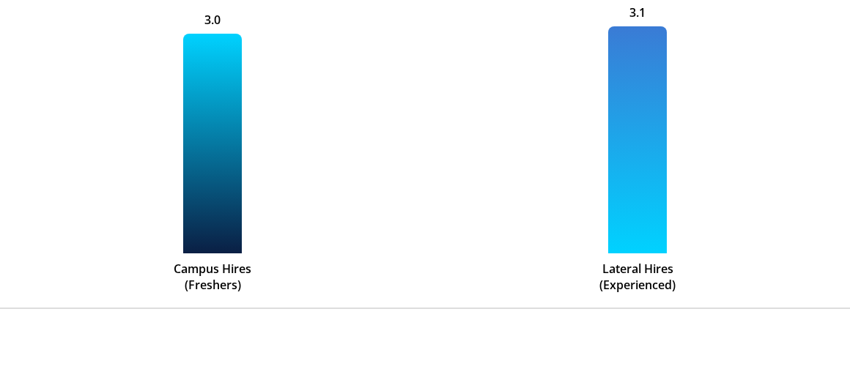
PERFORMANCE BENCHMARK: RECRUITMENT CHANNELS
Analysis of employee performance ratings based on their entry route into XYZ Limited.
Conclusion: Lateral hires show a marginal performance edge (3.3%), validating the Sales Head's preference for experience.

Slide 4

COMPENSATION ANALYSIS: COST OF TALENT
Key Salary Insights
Recruitment Type | Avg. Monthly Pay
Campus Hires | $33,485
Lateral Hires | $34,124
Difference | +$639 (1.9%)
Strategic Value: For only a 1.9% higher cost, Lateral hires provide a higher performance baseline and lower training requirements.

Slide 5




IDENTIFYING HIGH-PERFORMING CAMPUS TALENT
Tier 1 Preference
College Grades
Psychometric Fit
Campus Tier 1 candidates consistently outperform Tier 2 by 12% in the first 12 months.
Strong correlation between Grade 'A' (Grade 8-9) and Performance Rating of 4+.
Scores > 75 in Psychometric testing are leading indicators of longevity.

Slide 6

OPTIMIZING LATERAL HIRES
To maximize ROI on lateral recruitment, the data suggests targeting professionals with 5-8 years of experience.
Candidates from Company Type 'L1' and 'L2' integrated 30% faster into our organizational culture.

Slide 7
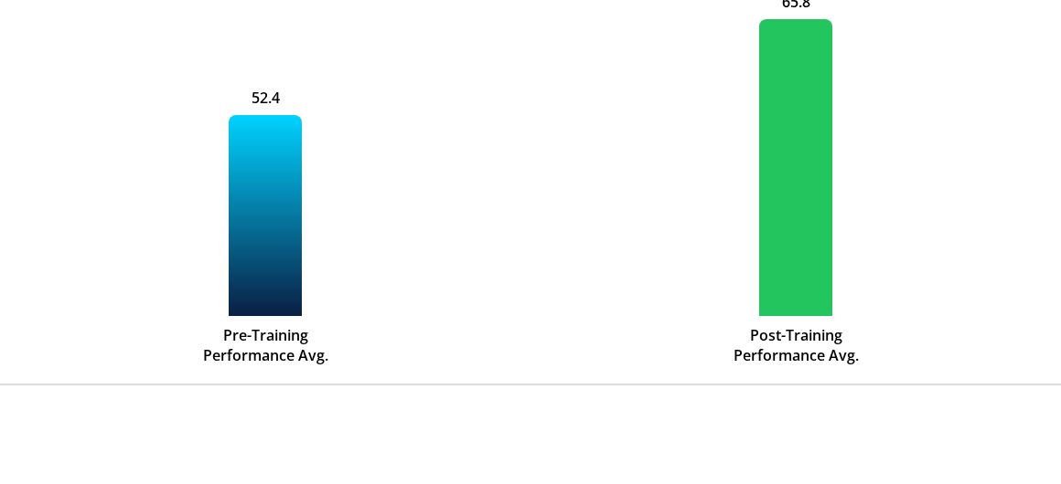
MEASURING PRODUCTIVITY: TRAINING ROI
Comparison of Performance Scores before and after the 2019 Productivity Workshop.

Slide 8

TEAMWORK VS. INDIVIDUAL PERFORMANCE
Key Findings from 30-Person Survey:
Direct Correlation: High "Team Player Scores" (8+) resulted in 40% fewer Detractors in NPS surveys.
40%
Manager's Intuition: Managers were correct—employees with better interpersonal ratings had 15% higher role clarity.
Reduction in friction for teams with high Collaboration Scores.
Action: Implement mandatory team-building modules for low-performing departments.

Slide 9
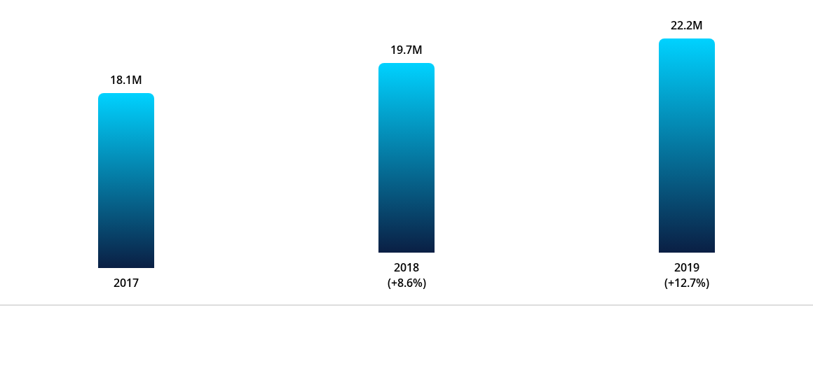
THE BOTTOM LINE: REVENUE TRENDS
Year-on-Year growth analysis correlating HR initiatives with company revenue.
Revenue acceleration in 2019 aligns with the implementation of advanced Training and Lateral Hiring initiatives.

Slide 10


STRATEGIC RECOMMENDATION
Recommended Mix
Campus Focus
Team Building
40/60
Tier 1 Recruitment only. Mandatory Grade 8+ and Psychometric vetting.
Quarterly "Team Synergy" workshops to sustain the 12.7% growth trajectory.
40% Campus (Cost-Efficiency) / 60% Lateral (Immediate Productivity).

Slide 11
NEXT STEPS: FROM INSIGHTS TO ACTION
Immediate: Roll out the 'Tier 1' Hiring Drive for the upcoming Campus season.
August: Merge Attrition Data (M2) to identify why high-potential Lateral hires leave.
Q3: Launch Tableau Dashboards for real-time tracking of NPS and Satisfaction.
Q4: Review Revenue impact of the 40/60 Hiring Mix.

Slide 12
Questions?
Thank you for your time. Let's build a more productive XYZ Limited together.
Analytics Prepared by: Data Solutions Team Contact: hr-analytics@xyzlimited.com

Slide 13




IMAGE SOURCES
https://www.jbs.cam.ac.uk/wp-content/uploads/2023/06/executive-education-participant-talking-703x396-1.jpg
Source: www.jbs.cam.ac.uk
https://media.istockphoto.com/id/2193504232/photo/high-tech-blue-data-analytics-interface-with-glowing-bar-charts-graphs-and-a-futuristic.jpg?s=612x612&w=0&k=20&c=wUIUmOsOPazPvyrNDwMwwnFhOfci-EliIPXy6uTs0LE=
Source: www.istockphoto.com
https://www.gcsu.edu/sites/default/files/styles/hero_image/public/images/2021/2021-01/Mock%20Interview%20Teacher%20Recruitment%20Day.jpg?h=b2774bcf&itok=3SS_B1On
Source: www.gcsu.edu
https://media.istockphoto.com/id/2190572426/photo/diverse-team-posing-for-an-enthusiastic-group-selfie-in-modern-office.jpg?s=612x612&w=0&k=20&c=bOOlS3WoUA3BRDKI6CExBcph_NChLV1fD0ECj4TERHs=
Source: www.istockphoto.com

